Slide 1

ML 24/25 Implement the visualization of permanence value
Team: permanence pixels
Information Technology Course
Module Software Engineering
by Damir Dobric / Andreas Pech
Submitted by Md Tiabur Rahman Tamim Md Shakaut kader Zaria Fahamida Jakia Sultana Jui

Slide 2
Objectives
The objective of this study is to investigate the reconstruction of Input in Hierarchical Temporal Memory (HTM) networks using the Neocortex API's Reconstruct method. Specifically, the study aims to: Reconstruction Method in NeoCortexApi.
Running Reconstruction
Visualize Permanence Values
Similarity Calculation between Original Encoded inputs and Reconstructed Input.(Both numerical inputs and Image Inputs)

Slide 3

Introduction
HTM (Hierarchical Temporal Memory)
Spatial Pooler (SP)
Reconstruct() Method
HTM model
Data Encoding in HTM

Slide 4
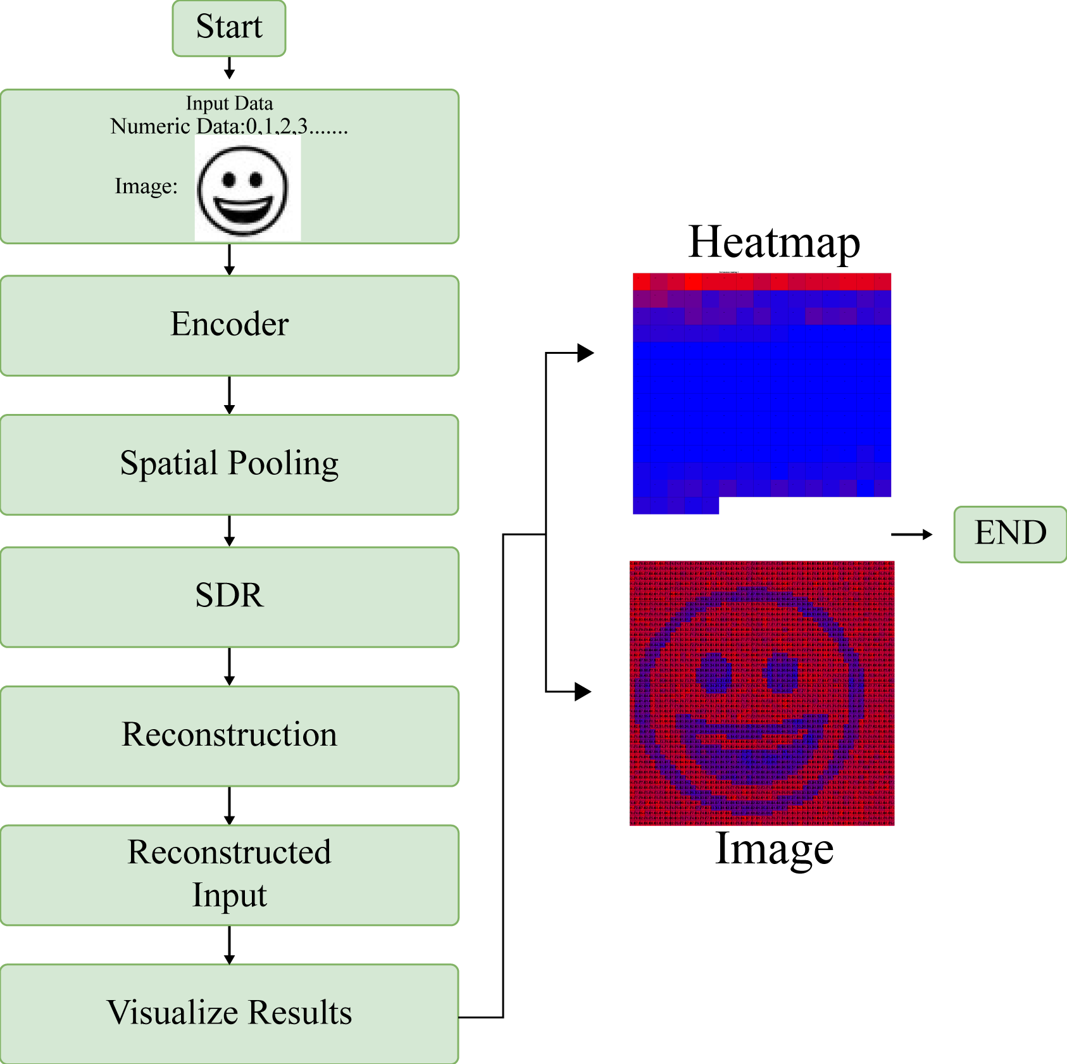
Methodology
Input Data (Image data and Numeric data): Transformed into binary format
Spatial Pooling: Identifies patterns and generates SDRs.
Reconstruction: Decodes SDRs to recreate the original input.
Result Visualization: Shows the reconstructed output for analysis.
Fig-1: Graphical Representation of the Experiment

Slide 5
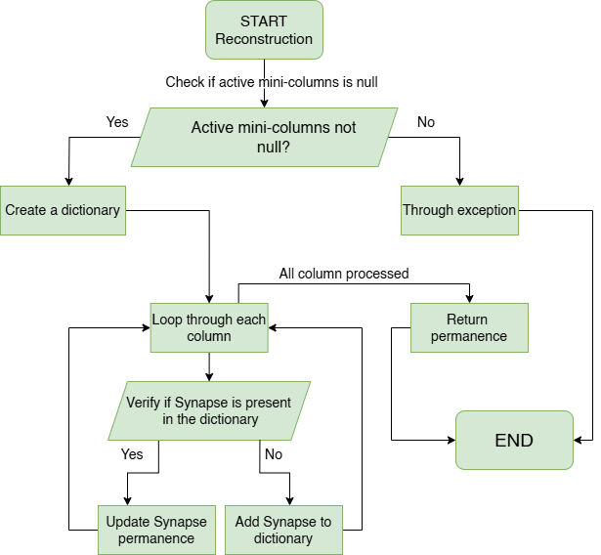
Reconstruction Method in NeoCortexApi
Fig-2: Graphical illustration of the workflow of the Reconstruction Method

Slide 6
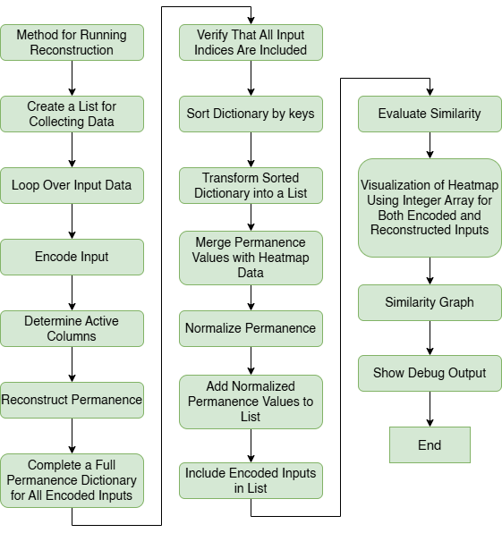
Input Reconstruction with Reconstruction Method
Fig-3: Graphical illustration of the workflow of the Reconstruction Method

Slide 7
Visualization Technique of the Permanence Values
Heatmap Visualization: Display permanence values as a color-coded heatmap.
Permanence Normalization: Scale permanence values using a defined threshold.
Encoded Input Comparison: Compare original encoded input with reconstructed output.
Similarity Measurement: Evaluate and display how closely the reconstruction matches the original input.

Slide 8
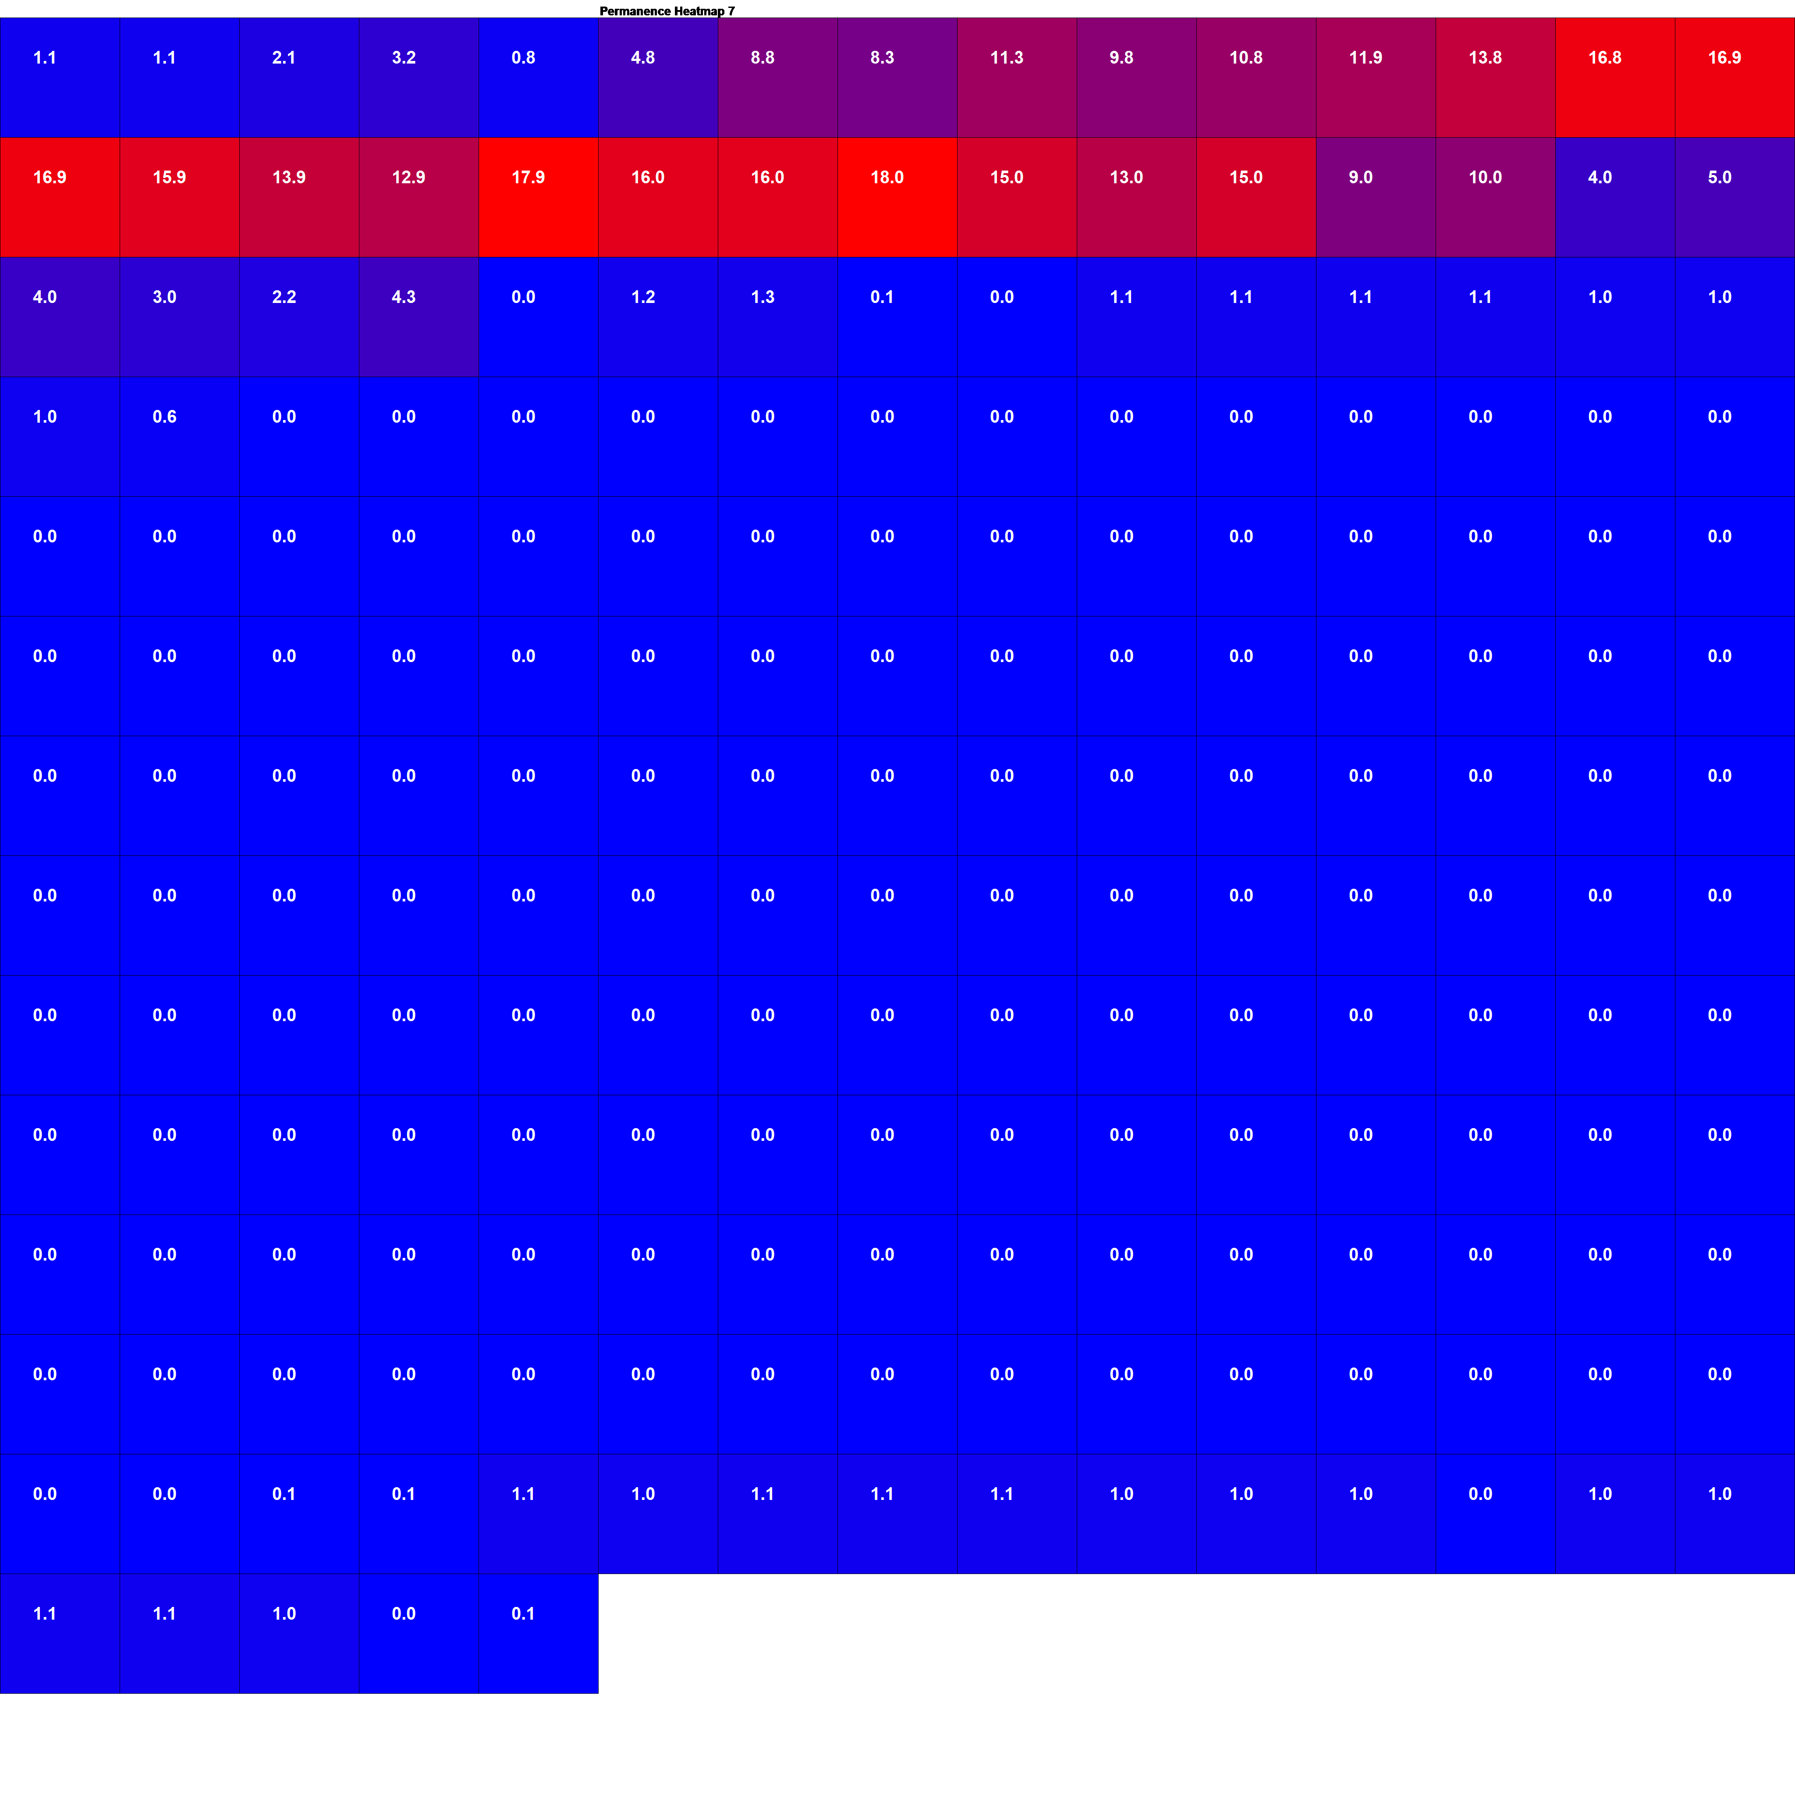
Visualization Result for Numerical Inputs
Fig-4: Reconstructed Heatmap Image for Numerical Input
Fig-5: Comparing Encoded vs. Reconstructed Numerical Inputs(After Thresholding)

Slide 9

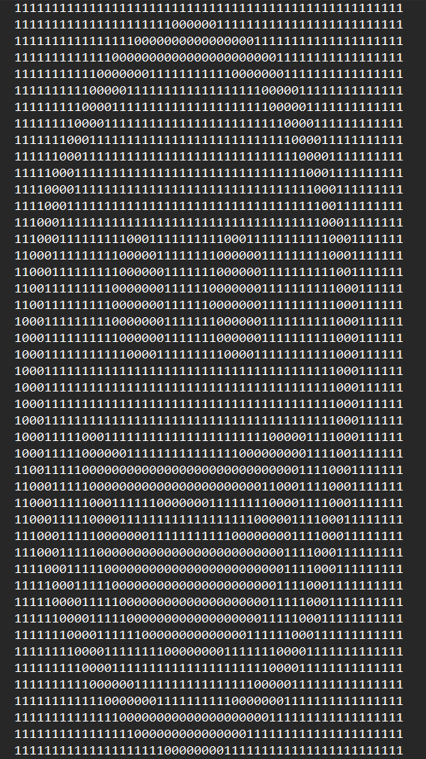
Visualization Result for Image Inputs
Fig-7: Binary Image reconstructed
Fig-8: Binary Image as Text Encoded
Fig-6: Image Heatmap

Slide 10
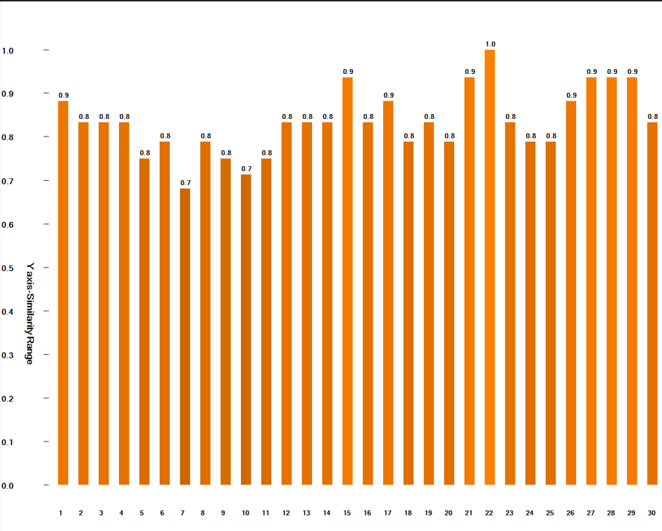
Similarity Graph for the Numerical Inputs

Slide 11
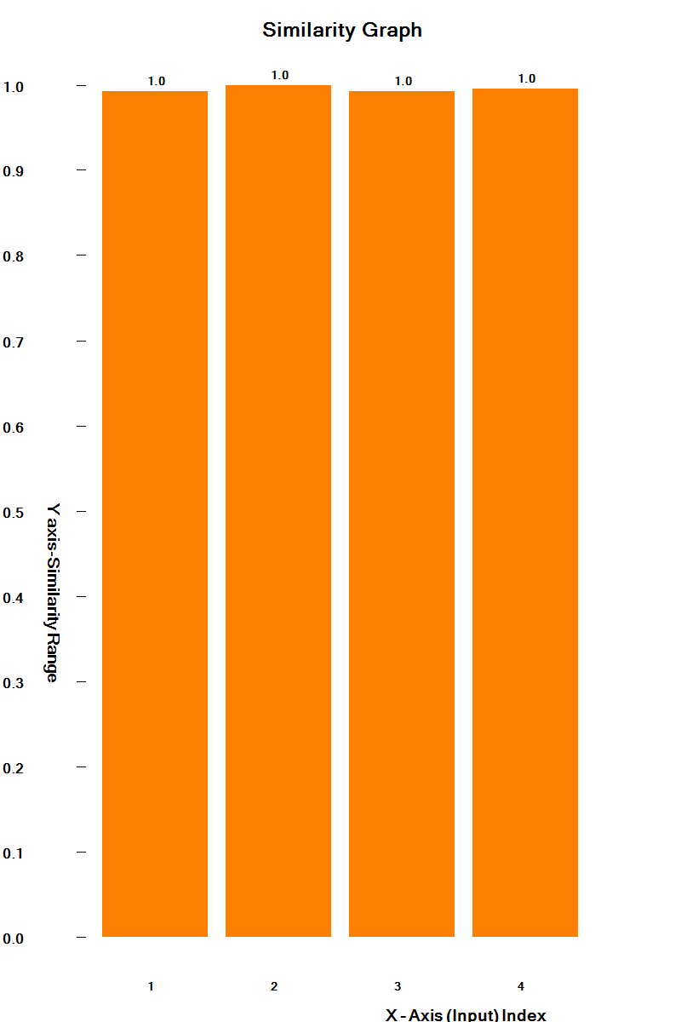
Similarity Graph for the Image Inputs

Slide 12
Conclusion
Input Reconstruction: Perform reconstruction for two input types: numerical data and image data.
Reconstruction Testing: Conduct unit tests to verify the accuracy of the reconstruction method.
Assumptions in Reconstruction: Consider specific assumptions and conditions applied during input reconstruction.

Slide 13
THANK YOU
Team: permanence pixels
Md Tiabur Rahman Tamim
Md Shakaut kader
Zaria Fahamida
Jakia Sultana Jui

